Slide 1

NEWS ARTICLE SUMMARIZATION
REVIEW - 1
BY
19K41A05E9 - B. SHREYA
19K41A05F0 - B. ARCHANA 20K45A0216 - K . RAJU
UNDER THE GUIDANCE OF
D. RAMESH

Slide 2
INTRODUCTION
Text Summarization is the technique for generating a concise and precise summary of voluminous texts.
Automatic text Summarization aims to convert the lengthy document into shortened version.
Machine learning algorithms can be trained to comprehend documents and identify the sections that convey important facts and information before producing the required summarized texts.

Slide 3
OBJECTIVES
The main objective of a text summarization system is to identify the most important information from the given text and present it to the end users.
For user’s to get the information quickly rather than reading all the lengthy documents to get the quick summary of it in a simple version is the main aim of this project.

Slide 4
BENEFICIARIES
Get’s to know the whole concept in shortened version, which is fast and time saving.
It is required to understand the key concept easily.
It helps in a person’s thought process to think other side and sometime out of the box.
Hard work can be converted into smart work.

Slide 5
Literature Survey
TITLE | Two-level text summarization from online news sources with sentiment analysis.
AUTHOR AND PUBLICATION YEAR | Tarun Miran and 2017.
DESCRIPTION | This paper is based on 2 level summarization in first level -the URLs are fetched as an input and two/three summaries are generated primarily from news articles by applying extraction-based method. Firstly it is applied on classifying tweets and reached an accuracy of 75% with SVM and later 90%accuracy with Decision and RF. Sentimental analysis is done to get a positive ,negative ,neutral opinion on the article.
MODELS | Random Forest, Decision tree
LIMITATIONS | it is subjected to only extractive based summarization.

Slide 6
Literature Survey
TITLE | NLP based Text Summarization Techniques for News Articles: Approaches and Challenges
AUTHOR AND PUBLICATION YEAR | Sara Tarannum, Piyush Sonar and 2021.
DESCRIPTION | This paper, describes a unique approach for extractive summarization with sentiment analysis for two-level text summarizing from online news sources. At first ,important sentences are extracted and individual summaries are prepared and later it is extended to sentimental analysis.
MODELS | LSTM
LIMITATIONS | is limited to extractive approach but abstractive approach has advance features like paraphrasing,high summary task.

Slide 7
Literature Survey
TITLE | A text abstraction summary model based on BERT word embedding and Reinforcement Learning.
AUTHOR AND PUBLICATION YEAR | Qicai Wang,Peiyu Liu and 2019.
DESCRIPTION | Firstly, we convert the human-written abstractive summaries to the ground truth labels. Secondly, we use BERT word embedding as text representation and pre-train two sub-models respectively. Finally, the extraction network and the abstraction network are bridged by reinforcement learning. To verify the performance of the model, we compare it with the current popular automatic text summary model, and use the ROUGE metrics as the evaluation method.Scores are evaluated in terms of Rouge metricsand accuracy is 95%.
MODELS | BERT,Reinforcement learning.
LIMITATIONS | Choosing best pre training model to perform better summary task.

Slide 8
Literature Survey
TITLE | Abstractive method of text summarization with sequence to sequence RNNs.
AUTHOR AND PUBLICATION YEAR | Abu Kaiser Mohammed Marum and 2019.
DESCRIPTION | Main purpose of this paper is to create an short,fluent,abstractive summary of text.In this experiment, successfully reduced the training loss with a value of 0.036 and abstractive text summarizer able to create a short summary of English to English text. Model used in this are the sequence to sequence model with a two-layered bidirectional RNN's. On the input text and two layers RNN's, each with an LSTM using on the target text to produce an extensive summary
MODELS | Seq2Seq model ,RNN
LIMITATIONS | This paper is supposed only for English text summarization ,but an individual can't access it in their native languages.

Slide 9
Literature Survey
TITLE | Abstractive text summarization with a CNN Seq2Seq model.
AUTHOR AND PUBLICATION YEAR | Yong Zhang, Dan li and 2019
DESCRIPTION | In this work, it tries to introduce an seq2seq generative model based on convolutional framework to produce abstract text summarization.In general Key sentences are considered when creating summaries of text, especially for those lengthy documents. It is not enough to simply identify the keywords. Therefore, we use the convolutional seq2seq model at the level of both words and sentences and obtained accuracy 80%. Later an hierarchical attention system is used to ensure functioning on both levels at once and Rouge evaluation is done to evaluate the scores.
MODELS | CNN ,Seq2Seq
LIMITATIONS | The accuracy can be improved in a better way.

Slide 10
Literature Survey
TITLE | Performance study on Extractive text summarization using BERT models.
AUTHOR AND PUBLICATION YEAR | shehab Abdel Salam , Ahmed Rafea and 20222
DESCRIPTION | Through a series of experiments, the goal of this paper is to produce a study on the effectiveness of BERT-based model variants for text summarization. then proposed an "SqueezeBERTSum," a trained summarization model tuned with the SqueezeBERT encoder variant, which achieved competitive ROUGE scores while retaining the BERTSum baseline model performance by 98%.
MODELS | BERT , RNN
LIMITATIONS | The experiment is only concised to Google collab where it doesn't allow hyperparameters tuning because of its GPU, so it can be extended by tuning the hyper parameters to get the best summary.

Slide 11
Literature Survey
TITLE | Abstractive social media text summarization using selective reinforced Seq2Seq attention model
AUTHOR AND PUBLICATION YEAR | Zeyu Liang ,Junping D.U and 2020
DESCRIPTION | Despite the recent success of several models built on the seq2seq structure, there are still a lot of issues that must be addressed. In this study, it suggest an attention model for abstractive social media text summarization called selected reinforced Seq2Seq,to more effectively filter out false information, a selective gate is added after the encoder module. Evaluations done on a well-known social media dataset (i.e., LCSTS) show that our model performs better than the majority of well-known baseline models, and the proposed model is 2.6%, 2.1%, and 2.5% higher than the fundamental Seq2Seq attention model on the score of individual Rouge Scores.
MODELS | Reinforcement learning and seq2seq
LIMITATIONS | The model can be further improved with more accuracy.

Slide 12
Literature Survey
TITLE | Abstractive text summarization using seq2seq model.
AUTHOR AND PUBLICATION YEAR | Nithin s.v ,Pranaav A.R and 2022.
DESCRIPTION | This paper introduces an abstract version of the text using the seq2seq model. The proposed approach aims to improve the efficiency of the summary produced with the help of a data augmentation strategy. The abbreviation combines new words and sentences thus enhancing its quality. To assess the quality of the summary of the bilingual test standard in understudy (BLEU) is used.Thee precision of this model is 75%
MODELS | LSTM ,seq2seq.
LIMITATIONS | he future work is to develop scales and produce large sections to obtain summaries.

Slide 13
Literature Survey
TITLE | Abstractive text summarization using LSTM- CNN based deep learning
AUTHOR AND PUBLICATION YEAR | Sheling Song, Haitao and 2018.
DESCRIPTION | This paper proposes an LSTM-CNN and based ATS framework that construct new sentences by exploring fine grade fragments than sentences named sematic phrases. The framework comprises of two stages,at first it extract pages from source sentence and second it generates text summaries using deep learning. The precision of the model used is 80%
MODELS | LSTM
LIMITATIONS | The competitive results can be achieved at an higher rate in future

Slide 14
Literature Survey
TITLE | Abstractive text summarization using LSTM's with rich features
AUTHOR AND PUBLICATION YEAR | Huong Le Thanh and 2019.
DESCRIPTION | In general abstractive text summarization is concised to short text but it doesn't work for summarizing long test, so here it uses an abstractive sumirization using LSTM model to overcome the weakness by training with two different datasets, they are English and other is Vietnamese dataset of daily mail and try to get an accuracy of and 89%.This proposed approach, solve the problem of recurrent neural networks that focus on the last part of input text.
MODELS | seq2seq and LSTM.
LIMITATIONS | since the quality of abstraction the Vietnamese daata that has data are not good it is necessary to build a summarization with better quality to get better accuracy.

Slide 15
Literature Survey
TITLE | A Text abstraction summary model based on BERT word embedding and reinforcement learning
AUTHOR AND PUBLICATION YEAR | Peiyu Liu and 2019.
DESCRIPTION | This paper tries to built a model of extractive-abstractive summary with BERT reinforcement learning. Firstly , human- written summary is converted to ground truth tables and then uses BERT ,embedd as text .Finally extraction and Abstractive summaries are bridged by Reinforcement learning. Performance is validated by comparing it with CNN model and scores are evaluated using Rouge Scores . The accuracy of the model used is 95%.
MODELS | BERT , Reinforcement learning.
LIMITATIONS | In future, try to propose a new method to combine the methods into a unified method that has been validated in summary Task or other task.

Slide 16
DATASET
We have collected data consisting of daily mail news articles to get done with text summarization.
We split the data into 3 divisions:
1. Training set
2. Testing set

Slide 17
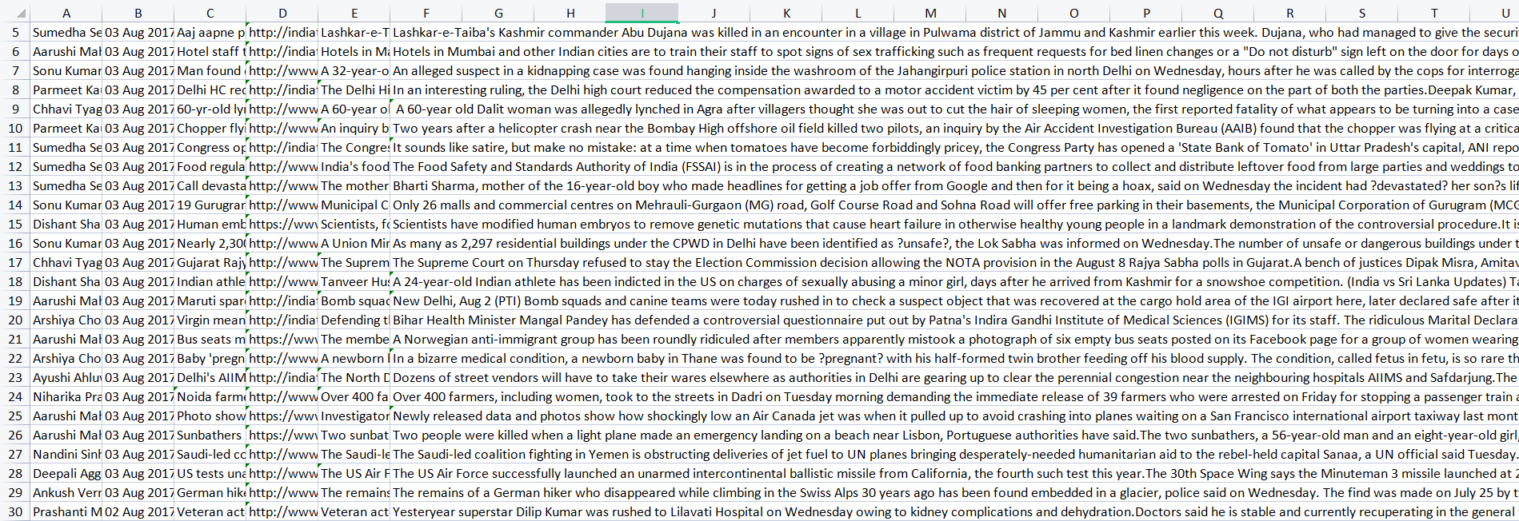
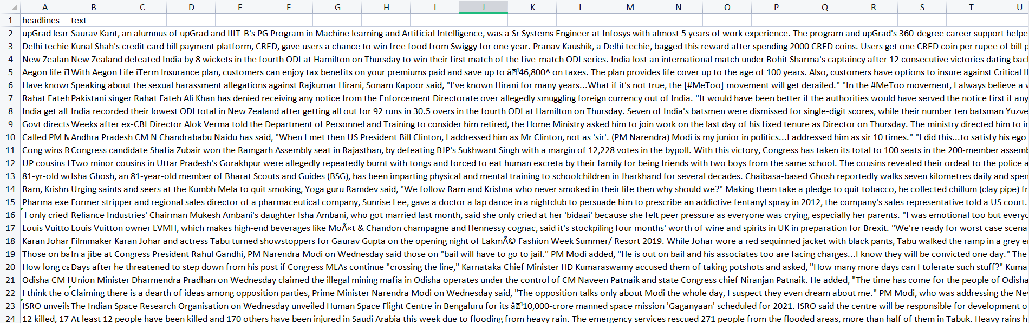
DATA INSIGHTS
INPUT FEATURE :
OUTPUT FEATURE :

Slide 18
ALGORITHM
We use LSTM model to develop an news article summarization.
LSTM is an Recurring Neural Network , where the same network is trained through sequence of inputs across time.
Long Short Term Memory use a series of gates which control how the information in a sequence of data comes into, is stored in and leaves the network.
There are three gates in a typical LSTM:
FORGET GATE
INPUT GATE
OUTPUT GATE
These gates can be thought of as filters and are each their own neural network.

Slide 19
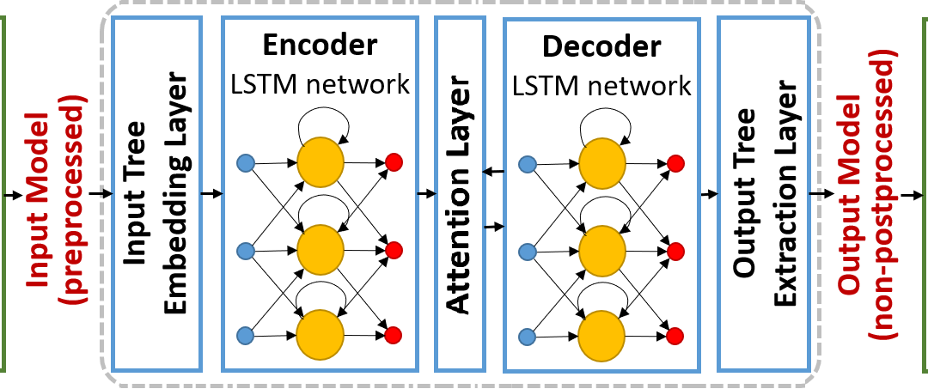
LSTM ARCHITECTURE

Slide 20
SEQ-2-SEQ
Seq2Seq2 model is a model that takes a stream of sentences as an input and outputs another stream of sentences
Encoder and Decoder are the two main techniques used in Seq2Seq2 modeling
ENCODER MODEL:
Encoder model is used to encode or transform the input sentences and generate feedback after every step.
Encoder models capture the vital information from the input sentences while maintaining the context throughout.
DECODER MODEL:
Decoder model is used to decode or predict the target sentences word by word.
Decoder input data takes the input of target sentences and predicts the next word which is then fed into the next layer for the prediction.

Slide 21
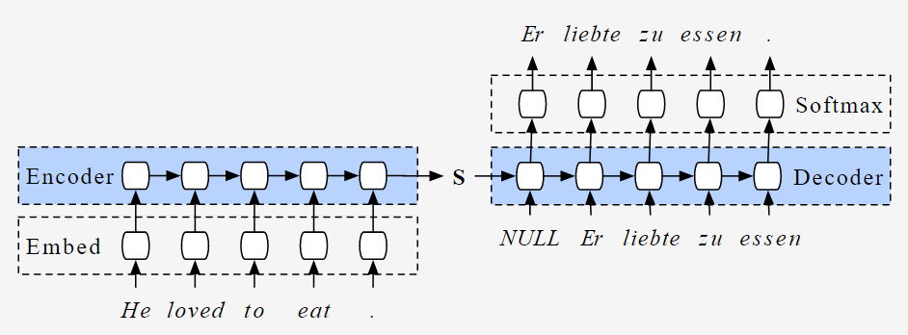
SEQ-2-SEQ Architecture

Slide 22
BERT
Bert is an open source machine learning framework for natural language processing
It is designed to help computers understand the meaning of ambiguous language in text by using surrounding text to establish context.
It is an Encoder stack of transformer architecture, the transformer encoder reads the entire sequence of words at once.
It travels both ways , so it’s non-directional.
Bert uses two training stratergies:
Masked LM
NEXT SENTENCE PREDICTION

Slide 23
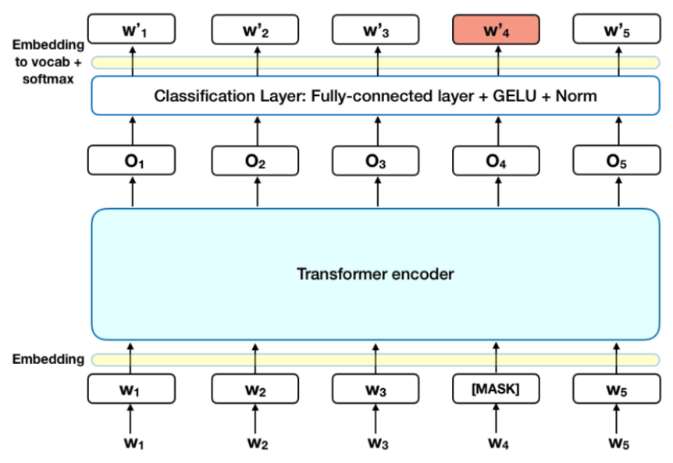
BERT Architecture

Slide 24
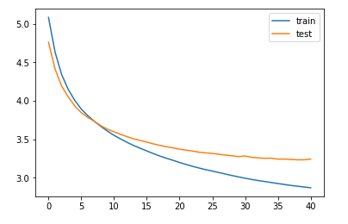
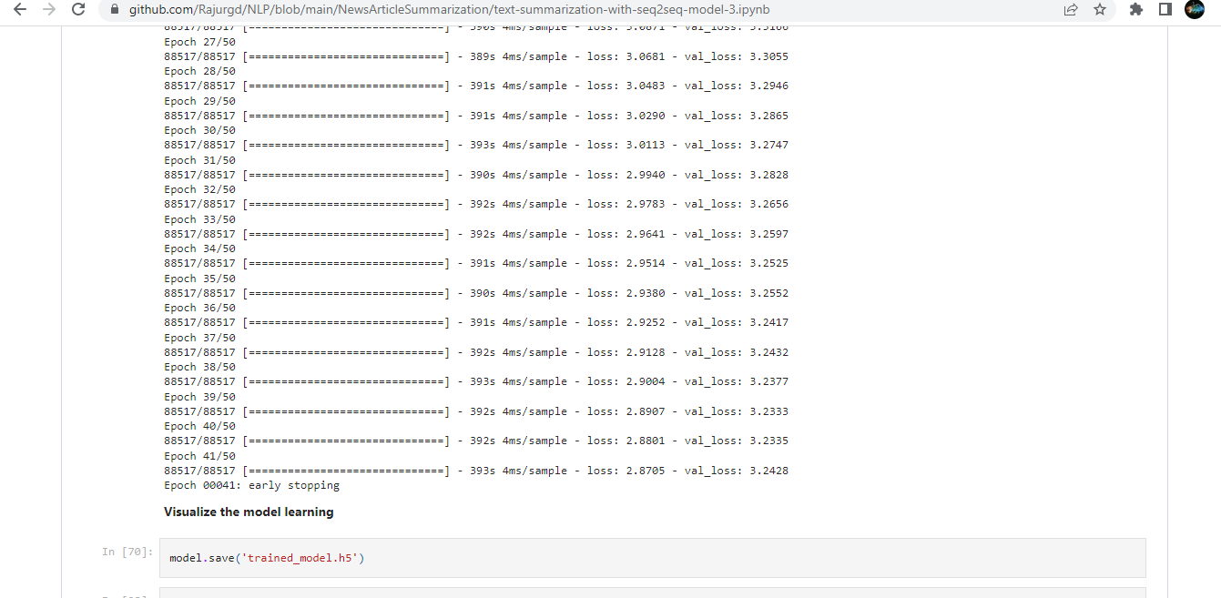
RESULT ANALYSIS
We used an machine learning algorithms in this project, and the algorithm LSTM have high level accuracies for our dataset. We consider testing accuracy for final deployment of the project. Here, the testing accuracy of LSTM is highest with 87%. As this model has highest accuracy , we use that model to develop the web application for the project. Accuracies with training and testing data of the model is represented in graphical and tabular form below.

Slide 25
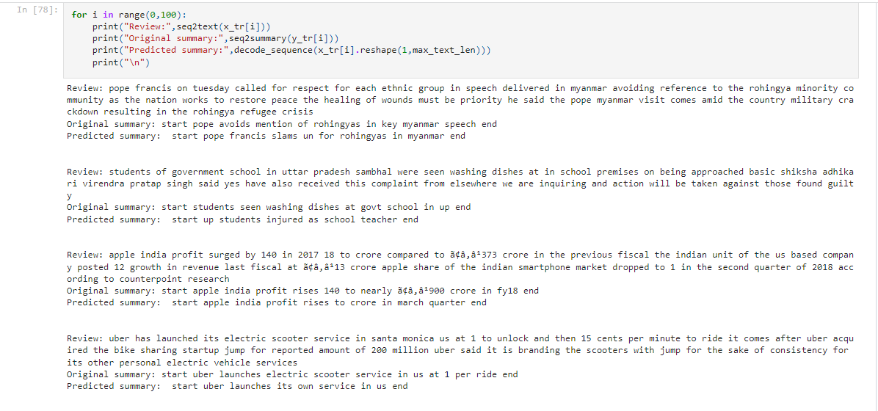
OUTPUT PREDICTED

Slide 26
CONCLUSION
In this approach We build algorithms or programs which will reduce the text size and create a summary of our text data. The Seq-2-Seq encoder-decoder model has been successfully applied along with LSTM to obtain good results on summarizing the text. The model is manipulated with an accuracy of 87% accordingly to produce human-written like summaries.
The future work is to improve the scalability and generalize large paragraphs to obtain summaries.

Slide 27
THANK YOU!!…

